Slide 1
Linked List Data Structure and Types
Dr Shantanu Pathak

Slide 2

Linked List
To store unlimited data elements
Gives sequential access to stored data elements
Ex.
Kites connected to each other
List of File blocks in Hard Disk
Iron Chain

Slide 3
Array vs Linked List
No | Array | Linked List
1 | Fixed Size | Dynamic Size
2 | Needs Continuous memory locations | Memory may not be continuous
3 | Memory Utilization is inefficient Because cannot increase / reduce size | Memory Utilization is efficient because, as per demand can increase / decrease size
4 | Accessing element is fast Because, random access to elements | Accessing element is slow Because, sequential access to elements
5 | Less memory required Because stores only elements | More memory than Array Because stores element and reference both
6 | If array is full then insertion operation takes more time or may be denied | Insertion in any case requires same amount of time

Slide 4
Types of Linked Lists
Singly Linked List
Doubly Linked List
Circular Singly Linked List
Node-based storage with arrays
Store linked list in array

Slide 5
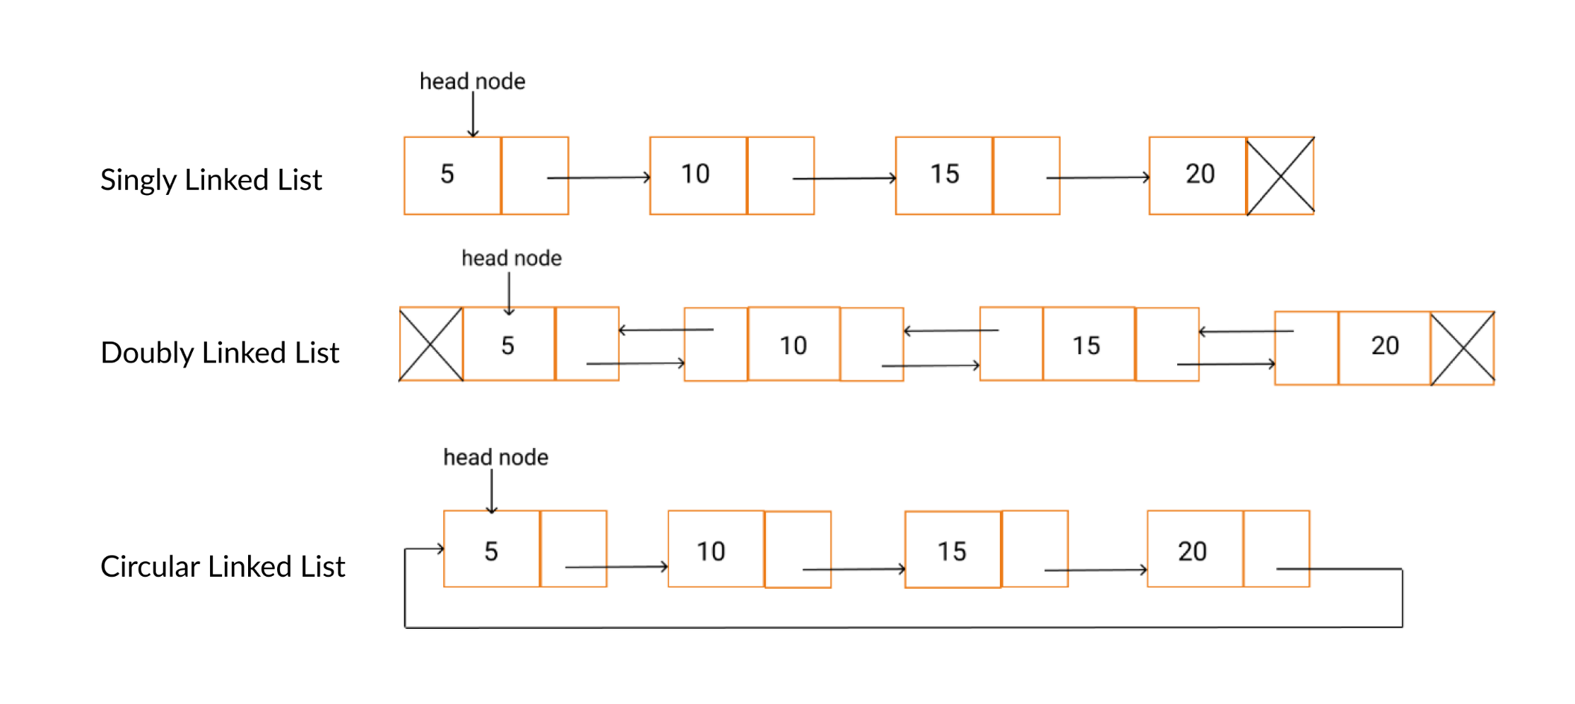
Types of Linked Lists

Slide 6
Singly Linked List Data Structure (D,F,A)
Domains
List of Employee Records
List of Book Records
Functions
Insert ( same as Insert_at_end)
Insert_at_begining
Remove ( same as Remove_from_end)
Remove_from_beginning
Display
Search
Axioms / Assumptions
Every element contains data and link reference to the next element
In Last element of list reference is NULL
‘head’ reference always refers to first element of the linkedlist

Slide 7
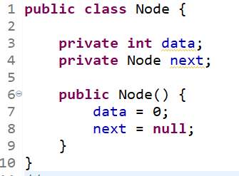
Singly Linked List Node
Create separate class for node
Contains relationship
Linked list contains node
Each node
Data
Next reference
Data : can be int / char / any object
Initialize as per need
Next reference : reference of Class Node
Initialize to null
Getter / setter in Node class

Slide 8
SLL Working
Insert Node
When list empty
At the end
Insert at position
At the beginning
At the end
In between position
Invalid position
Remove Node
When list is empty
From end
Remove from position
From beginning
From end
From in between position
Invalid position
Remove Complete Linked List
Display / Search

Slide 9
SLL memory management
Important
in creating new node
Always set reference to next node as NULL
in Removing a node
Remove the reference to a node, then node is automatically garbage collected
in Removing Complete Linked List
Make the head as NULL complete list will be garbage collected (step by step)
NOTE :: In case of very big linked list it may slow down the application

Slide 10
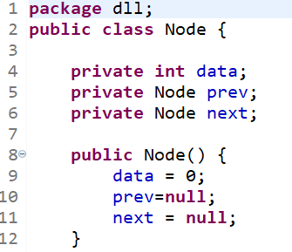
Doubly Linked List Node
Create separate class for node
Contains relationship
Doubly Linked list contains node
Each node
Data
Prev & Next reference
Data : can be int / char / any object
Initialize as per need
Prev & Next reference : reference of Class Node
Initialize to null
Getter / setter in Node class

Slide 11
DLL Working
Insert Node
When list empty
At the end
Insert at position
At the beginning
At the end
In between position
Invalid position
Remove Node
When list is empty
From end
Remove from position
From beginning
From end
From in between position
Invalid position
Remove Complete Linked List
Display / Search

Slide 12
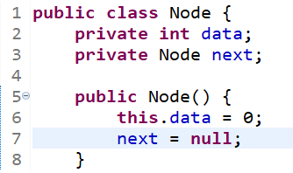
Circular Singly Linked List Node & Working
Node is same as Singly Linked List (SLL)
All operations like SLL
Only change in operations::
Last node is connected to head
So, last node is detected by
node.getnext() == head → then it is last node
So change operations accordingly

Slide 13
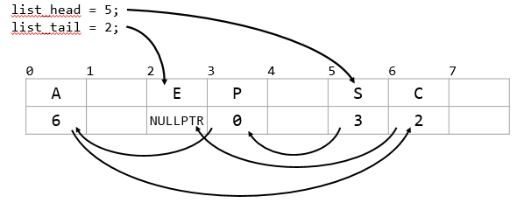
Node-based storage with arrays
Linked List drawback
New node creation → needs to call OS
Adding many nodes at a time → inefficient
Solution
Create an array one time and store nodes in it like Linked List

Slide 14
Linked List Key Notes
Array vs Linked list -> Imp
SLL -> as stack
SLL -> as queue
DLL Node similar to Binary Tree Node
CLL -> how to find the end node?

